Slide 1

HRI interface comparisons (VR, AR, bio-signal-based) Sebastian Hirt

Slide 2
Agenda
01
Why compare?
02
Specific examples for VR
03
Specific example for AR
04
Specific example for bio-signal-based
05
Comparison
06
What is the best path forward?

Slide 3
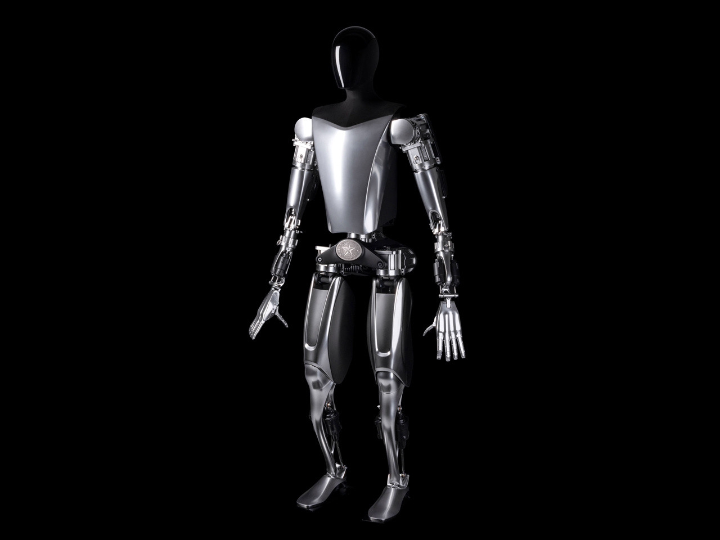
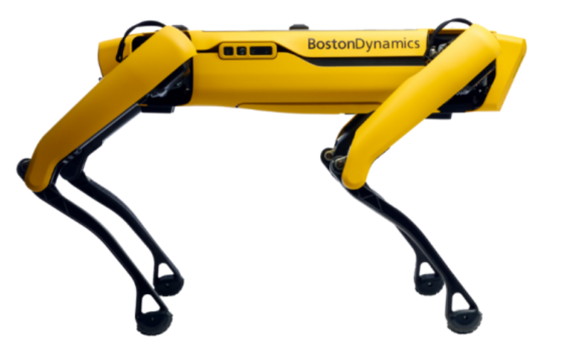
Why compare?
Best option for current use in industry
Dictate direction of future research
(Boston Dynamics, 2022)
(Tesla, 2022)
Notes:
Future robots need interfaces, if not fully autonomous (on the way there anyway)
Swarm control for spot
Spot, robot dog: carrying, surveying, traversing terrain

Slide 4
Agenda
01
Why compare?
02
Specific examples for VR
03
Specific example for AR
04
Specific example for bio-signal-based
05
Comparison
06
What is the best path forward?

Slide 5
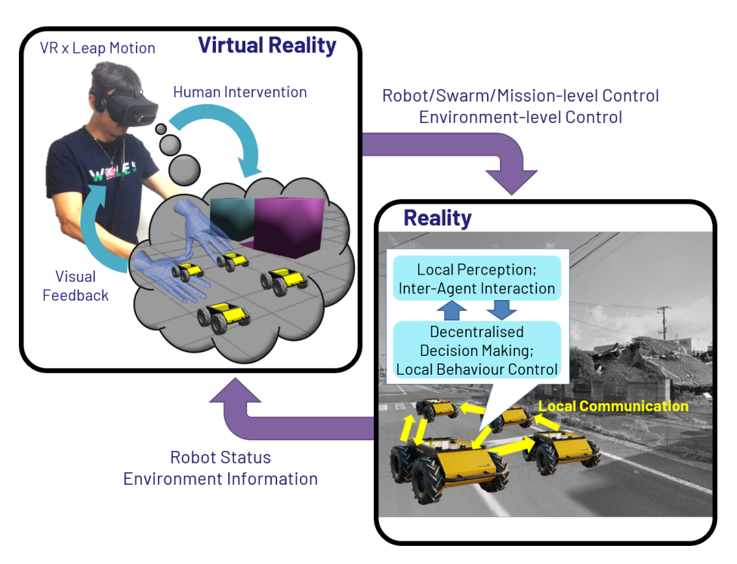
Specific Example for VR
Omnipotent Virtual Giant for Remote Human–Swarm Interaction
Control over swarm of robots like a swarm of ants
Oculus Rift headset with Leap Motion
Placing virtual objects in path of robot via environmental manipulation
Zoom in and out of the virtual environment
Teleoperation possible
Intuitive and feasible but might need training
(Jang et al., 2021)
Notes:
Pick up and placing of robot also possible
N=10 age 20-35 engineering background:
Test missions are accelerated
Some actions need training (even with perfect subject!)

Slide 6
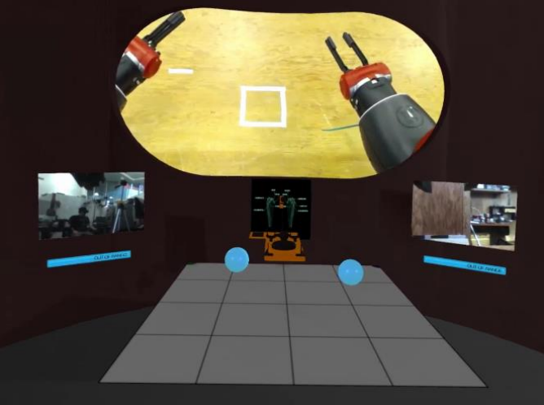
Specific Example for VR
Baxter’s Homunculus: Virtual Reality Spaces for Teleoperation in Manufacturing
Control robot arms with VR controllers
Oculus Rift headset with default controllers
Teleoperation for work in unsafe environments
Collocation in robot head
Pick up and place blocks
(Lipton et al., 2017)
Notes:
Consumer grade hardware
Use from save environment
Human can use side cameras in robot arms to align boxes

Slide 7
Agenda
01
Why compare?
02
Specific examples for VR
03
Specific example for AR
04
Specific example for bio-signal-based
05
Comparison
06
What is the best path forward?

Slide 8
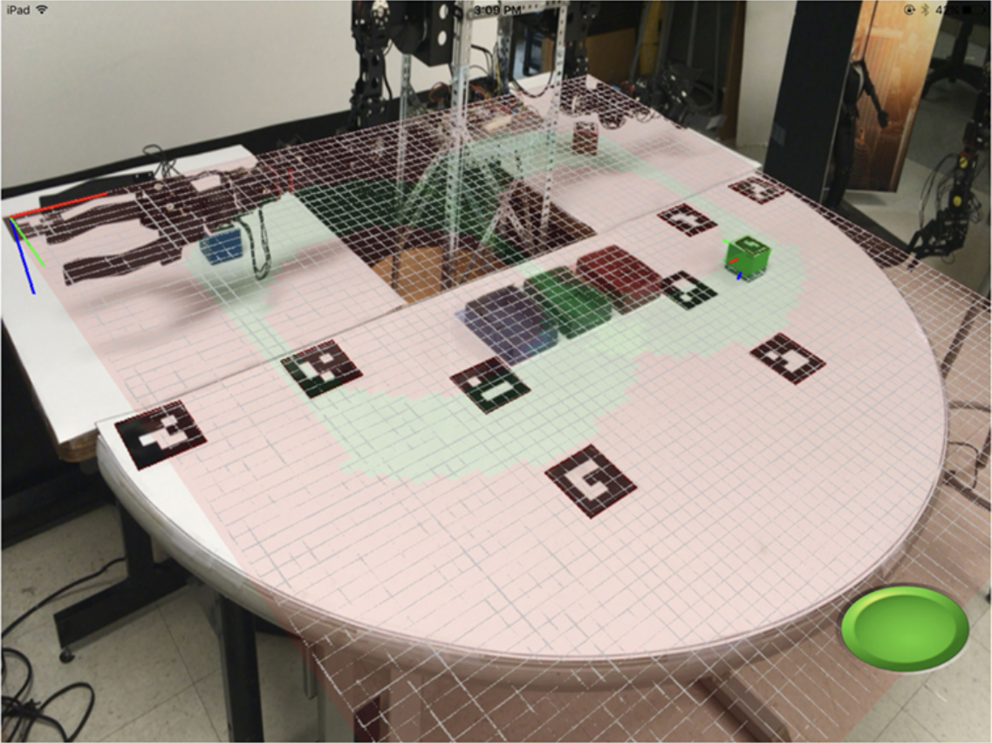
Specific Example for AR
Mobile Mixed-Reality Interfaces That Enhance Human–Robot Interaction in Shared Spaces
Visualization of information about robot in shared space
Mobile tablet as camera and controller
Environmental markers on table
Showing range of motion of robot
Pre render potential future moves of the robot
(Frank et al., 2017)
Notes:
Control via accelerometer
Other methods with cameras:
Exocentric: on ceiling
Egocentric: on head (tiltable)
Pretrial better for users with AR plots enabled
No teleoperation (need to be in same environment)

Slide 9
Agenda
01
Why compare?
02
Specific examples for VR
03
Specific example for AR
04
Specific example for bio-signal-based
05
Comparison
06
What is the best path forward?

Slide 10
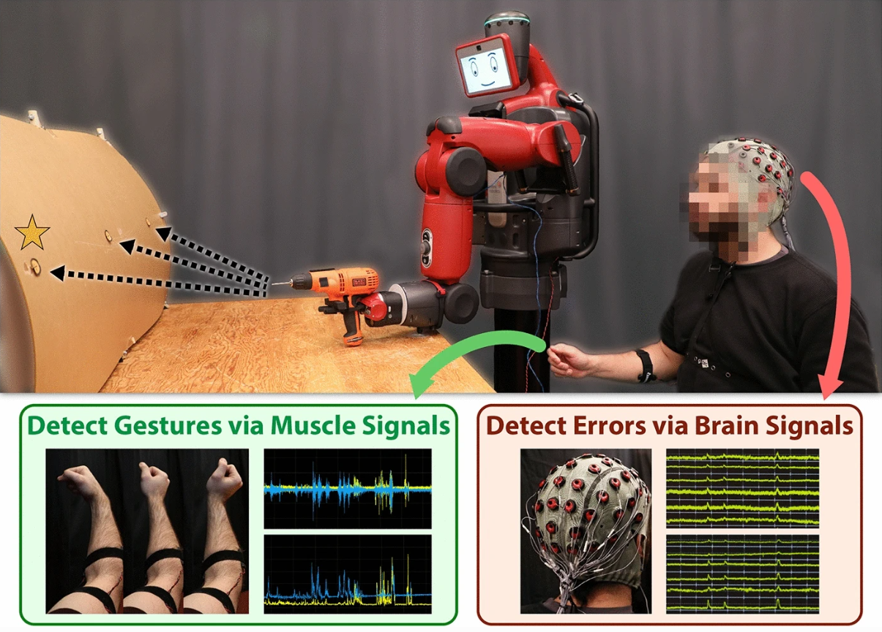
Specific Example for bio-signal-based
Plug-and-play supervisory control using muscle and brain signals for real-time gesture and error detection
Classification of left- and right-hand gestures via muscle signals (EMG)
Error recognition through brain function (EEG)
Combination in hybrid system
Tested on 7 subjects (plug and play) to reduce barrier of entry for new users
Shows potential, but more training data needed for higher reliability
(DelPreto et al., 2020)
Notes:
Hit three holes in wall with electric screwdriver
Mistakes can get recognized unconsciously, really fast
N=7, Accuracy: Random choice 70% (15%,15% for wrong targets, 70% for correct one), with human intervention 97%
Neural net classification (error-noerror) only 54% accuracy

Slide 11
Agenda
01
Why compare?
02
Specific examples for VR
03
Specific example for AR
04
Specific example for bio-signal-based
05
Comparison
06
What is the best path forward?

Slide 12
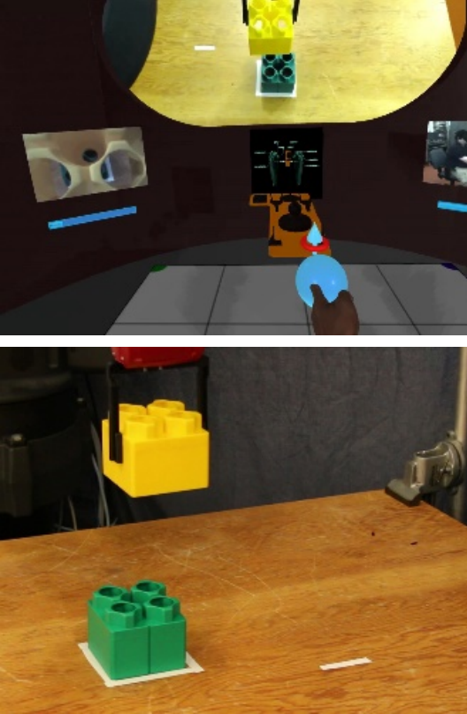
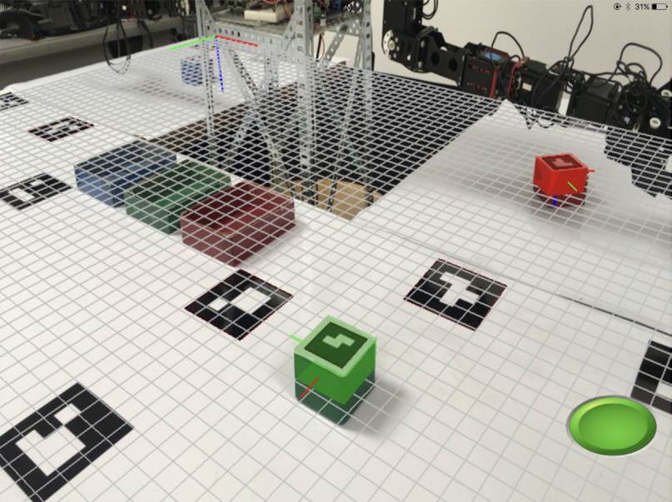
General comparison
Use Cases
VR
Teleoperation
Swarm control
AR
Display important robot information (range of motion/wear and tear)
Bio-signal-based
Control robot with mind (EEG) or muscles (EMG)
(Frank et al., 2017)
(Lipton et al., 2017)
Notes:
-VR: different environment, birds eye view
-AR: VR could do the same with front camera, but more expensive
-Bio-signal-based: faster reactions than VR/AR as direct link, but not reliable yet

Slide 13
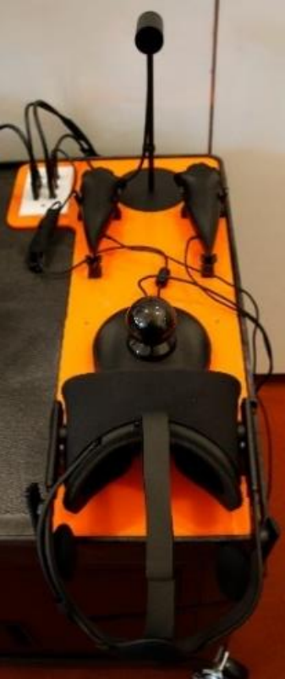
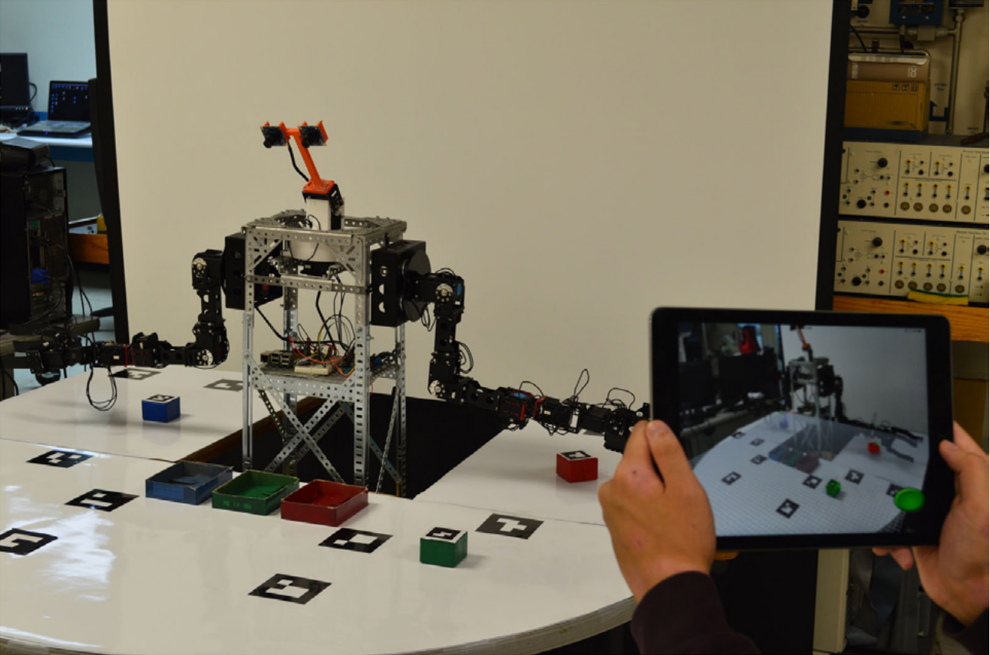
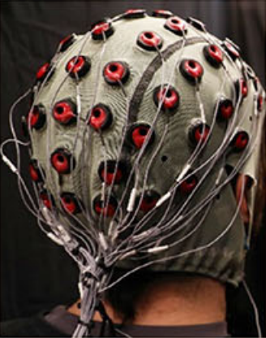
General comparison
Devices
VR
Meta Quest 2/Pro
Valve Index
AR
Tablet/Smartphone
Google Glasses
Bio-signal-based
Wrist band
Electrode hat
(Frank et al., 2017)
(DelPreto et al., 2020)
(Lipton et al., 2017)
Notes:
-VR: consumer grade devices, default controllers or razer hydra hand trackers; also, smartphone possible, but low res, not as powerful
-AR: consumer grade devices
-Bio-signal-based: maybe Implants at some point, often custom made (expensive)

Slide 14
General comparison
Cost
VR
Expensive Headsets
Cheaper through consumer products
AR
Low end cheapest solution
High end more expensive than low end VR
Bio-signal-based
Difficult to evaluate, mostly custom devices
Technology | Device | Cost ($)
VR | Meta Quest 2 | 450
VR | Valve Index | 1079
AR | I-Pad | 449
AR | Galaxy Tab S8 | 200
AR | Google Glasses | 999
Bio-signal-based | EEG electrode hat | 1500
Notes:
-VR: mass market products; high end PC required
-AR: no PC required, controller and screen in one
-Bio-signal-based: maybe Implants at some point, often custom made (expensive)

Slide 15
General comparison
Future potential
VR
Taking over control of “almost fully” autonomous systems remotely
AR
Integration into traditional glasses or even contact lenses
Increase trust in everyday robots
Bio-signal-based
Implants/EEG: huge potential to merge with robots and full control of a robot with a human's thoughts
Notes:
VR: help in dangerous environments remotely
AR: show future actions of robots to increase trust
Bio signal based: makes controls obsolete, sensing might be possible as well
bio-signal-based most potential, but VR/AR critical niche roles

Slide 16
Agenda
01
Why compare?
02
General Comparison on different Categories
03
Specific examples for VR
04
Specific example for AR
05
Specific example for bio-signal-based
06
What is the best path forward?

Slide 17
Best path forward
End goal:
Bio-signal-based control of robots with human thoughts
Intermediate steps:
Gradual development of all three technologies
VR
Ability to wear headsets for longer
Training programs
AR
Better integration into glasses
Bio-signal-based
Higher reliability necessary to be save to use
Notes:
VR: better form factor, faster generation of virtual environments
AR:
Bio-signal-based: more consumer-based products to accelerate development
In industry now: heavily depends on application, look at unique functions, then compare
More objective interdisciplinary metric to compare user metrics

Slide 18
Thank you!

Slide 19
Literature
Tesla Artificial Intelligence & Autopilot. (2022). Retrieved 7 February 2023, from https://www.tesla.com/AI
Boston Dynamics Spot Product Page. (2022). Retrieved 7 February 2023, from https://www.bostondynamics.com/products/spot
Jang, I., Hu, J., Arvin, F., Carrasco, J., & Lennox, B. (2021). Omnipotent Virtual Giant for Remote Human--Swarm Interaction. 2021 30th IEEE International Conference on Robot & Human Interactive Communication (RO-MAN), 488–494. IEEE.
Lipton, J. I., Fay, A. J., & Rus, D. (2017). Baxter’s homunculus: Virtual reality spaces for teleoperation in manufacturing. IEEE Robotics and Automation Letters, 3(1), 179–186.
Frank, J. A., Moorhead, M., & Kapila, V. (2017). Mobile mixed-reality interfaces that enhance human--robot interaction in shared spaces. Frontiers in Robotics and AI, 4, 20.
DelPreto, J., Salazar-Gomez, A. F., Gil, S., Hasani, R., Guenther, F. H., & Rus, D. (2020). Plug-and-play supervisory control using muscle and brain signals for real-time gesture and error detection. Autonomous Robots, 44(7), 1303–1322.
Dianatfar, M., Latokartano, J., & Lanz, M. (01 2021). Review on existing VR/AR solutions in human–robot collaboration. Procedia CIRP, 97, 407–411. doi:10.1016/j.procir.2020.05.259
Meta Shop. (2022). Retrieved 7 February 2023, from https://www.meta.com/de/en/quest/products/quest-2/
Steam Valve Index Shop. (2022). Retrieved 7 February 2023, from https://store.steampowered.com/valveindex
Apple IPad Shop. (2022). Retrieved 7 February 2023, from https://www.apple.com/shop/buy-ipad/ipad
Samsung Tablet Shop. (2022). Retrieved 7 February 2023, from https://www.samsung.com/us/tablets/galaxy-tab-s8/buy/
Open BCI Shop. (2022). Retrieved 7 February 2023, from https://shop.openbci.com/collections/frontpage
Robertson, A. (2019). Google announces a new $999 Glass augmented reality headset. Retrieved 7 February 2023, from https://www.theverge.com/2019/5/20/18632689/google-glass-enterprise-edition-2-augmented-reality-headset-pricing
Robertson, A. (2017). Oculus Rift and Touch are now $200 cheaper. Retrieved 7 February 2023, from https://www.theverge.com/2017/3/1/14779460/oculus-rift-touch-vr-bundle-price-drop-200
Notes:
*Please remove the parenthesis in the final version!!

